Slide 1
AI – Use Cases
Deployed in Production
Sep’2024

Slide 2
ID: CIS-001
Topcoder BiTS (Internal)
SOLUTION:
Deployment of SmartOps in the BiTS environment.
Smart ops augment L2 engineer with steps to resolve the issue.
Also, it gives details on infrastructure status related to tickets that helps engineer to resolves the tickets faster. Thus, reducing the MTTR.
SCOPE
Using AI to overcome the challenge of higher MTTR, and skilled engineer requirement for L3 issues
USERS / BENEFICIARIES
ITSM employees
GO LIVE: <Dec 2023>
BENEFITS REALIZED:
~20% reduction of MTTR in last 6 months.
AI TECNOLOGY
OpenAI, AutoGPT, Python, ML and Deep learning tools

Slide 3
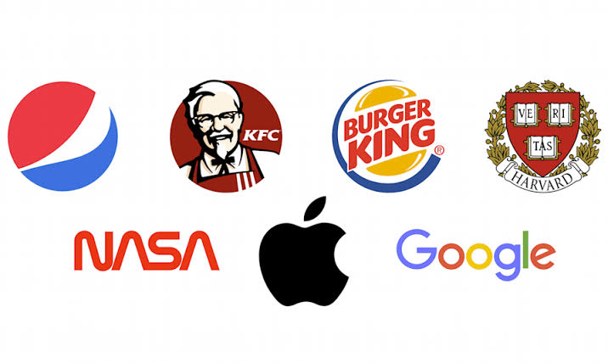
ID: DOP-003 to 019
TSafe
SOLUTION:
TM
- Springer Nature
We've implemented TSafe™, an adaptable end-to-end Pharmacovigilance automation platform renowned for its unparalleled precision in automation. Equipped with cutting-edge technologies such as Natural Language Processing (NLP) for Named Entity Recognition (NER), Artificial Intelligence (AI)/GenAI, and Python integration, it stands at the forefront of innovation in pharmacovigilance solutions.
SCOPE
TSafe™ is a flexible Pharmacovigilance (PV) intelligent automation platform to support end-to-end PV operations with the highest level of automation accuracy. It has Modules for the Automation of Case Receipt, automated Safety Database Entry, Literature Automation, Emails, E2B, etc.
TaloSafe Features:
Equipped with latest technologies like NLP to do NER, AI/GenAI, Python.
Intake channels equipped with cognitive BOTS for seamless case auto-uploading
Compatible with all the industry standard Safety Databases
Provision of multiple roles to segregate tasks effectively
Compliant with regulatory and system validation requirements
A combination of inhouse developed AI classifier combined with GenAI (Open AI API's)
USERS / BENEFICIARIES
GO LIVE: <NOV 2023>
BENEFITS REALIZED:
17 global pharma customers are live on Talosafe in Life Sciences space.
35% – 45% lower cost of ownership for customer due to shared services model.
~99% Article classification precision.
~30% Processing Efficiency
100% De-duplication accuracy
AI TECHNOLOGY
Using cutting-edge technologies like NLP for NER, AI/GenAI, and Python integration.

Slide 4
Thank you
https://www.topcoder.com/ai/

